Slide 1


The Urban Rani Series
STORIES OF GENERATIONAL GRIT
A Marketing Plan for Shaya

Slide 2



From Palace to Pavement
We are shifting the narrative from "Royal History" to "Modern Resilience".
The Legacy of the Past
The Grit of Today
History is about what was.
Legacy is about what you build now.
It's delicate silks, temple walls, and a queen you admire from a distance.
It's concrete, sweat, rhythm, and the strength you carry every single day.
Key Emotion: Nostalgia
Key Emotion: Empowerment

Slide 3






The Women Who Build
Three personas. One shared spirit.
The Creator
The Voice
The Fighter
An Architect who finds beauty in raw structure. "Built to Create"
A Drummer who commands the room with rhythm. "Built to Rule"
A Wrestler who turns struggle into strength. "Built to Last"

Slide 4
Setting the Scene
Persona | The Atmosphere | The Look | Key Prop
Architect | Dusty construction site. Unfinished concrete. | Power Dressing. Blazer over jewelry. | Blueprints & Stone
Drummer | Soundproof garage. Cables and chaos. | Rock chic. Leather & Denim. | Broken Drumsticks
Wrestler | Old-school gym. Haze and sweat. | Raw athletic. Sports bra & Tape. | Heavy Chains

Slide 5
Moments of Resilience
The Video Flow for our Character Reels
Preparation
Creation
Expression
Legacy
The Wrestler tapes her hands. She bites the tape. Intensity.
The Architect slams blueprints on concrete. Dust flies. Impact.
The Drummer strikes the cymbal. The jewelry vibrates. Rhythm.
Oxidized silver resting on raw concrete. Endurance.

Slide 6

The Brand Anthem
Format: A fast-paced, high-energy Vertical Reel.
0:00
Close up of the Choker. Texture focus.
SFX: Heavy bass drop. 🔊
0:02
Walking in a subway tunnel. Leather jacket.
Text: LEGACY?
0:05
Flash cut: Temple Sketch (B&W) ⮕ Jewelry (Color).
SFX: Glitch Sound.
0:08
Model looks at camera. Adjusts ring.
Text: IT'S NOT HISTORY.
0:15
Montage: Laughing, Running. City Skyline.
Text: IT'S HERSTORY. NOW.

Slide 7
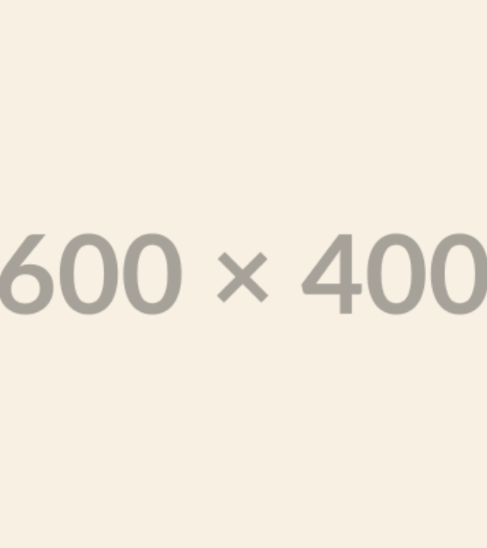
The "Glitch in Time" Grid
A visual strategy that disrupts the scroll.
We use a Triptych Layout (3 posts per row) to tell a complete story:
1. The Artifact A macro shot of the prop (e.g., a broken drumstick).
2. The Portrait The Hero Video of the woman in her element.
3. The Detail Extreme close-up of the jewelry on sweating skin.

Slide 8
A Week of Stories
Day | Format | The Hook
Monday | Reel (Teaser) | "You think you know royalty? Think again." Jewelry thrown on concrete.
Tuesday | Carousel | "Desk to Dynasty." Styling for the 9-to-5 warrior.
Wednesday | Static Image | "Details from 740 AD. Vibe from 2024." Red neon lighting close-up.
Thursday | Collab Reel | "The Versatility Test." One choker, three non-ethnic looks.
Friday | Story Polls | "Pick your weapon." Safe vs. Bold vibes.

Slide 9





Partners with Purpose
Real women who embody the "Urban Rani".
Anjali Mody
Aarifah Rebello
Pooja Dhanda
Founder, Josmo Studio
Drummer / Songwriter
Indian Wrestler
Authentic creator. She builds spaces, just as Rani Lokmahadevi built temples.
Her distinctive style and rhythm embody the "voice" of the modern queen.
She redefines strength. Proof that jewelry can be armour.

Slide 10


Let's Build This Legacy.
Immediate Next Steps
Confirm Talent Dates
Approve Production Budget
Secure Hero Inventory

